Slide 1
CYBERSECURITY CHALLENGES

Slide 2
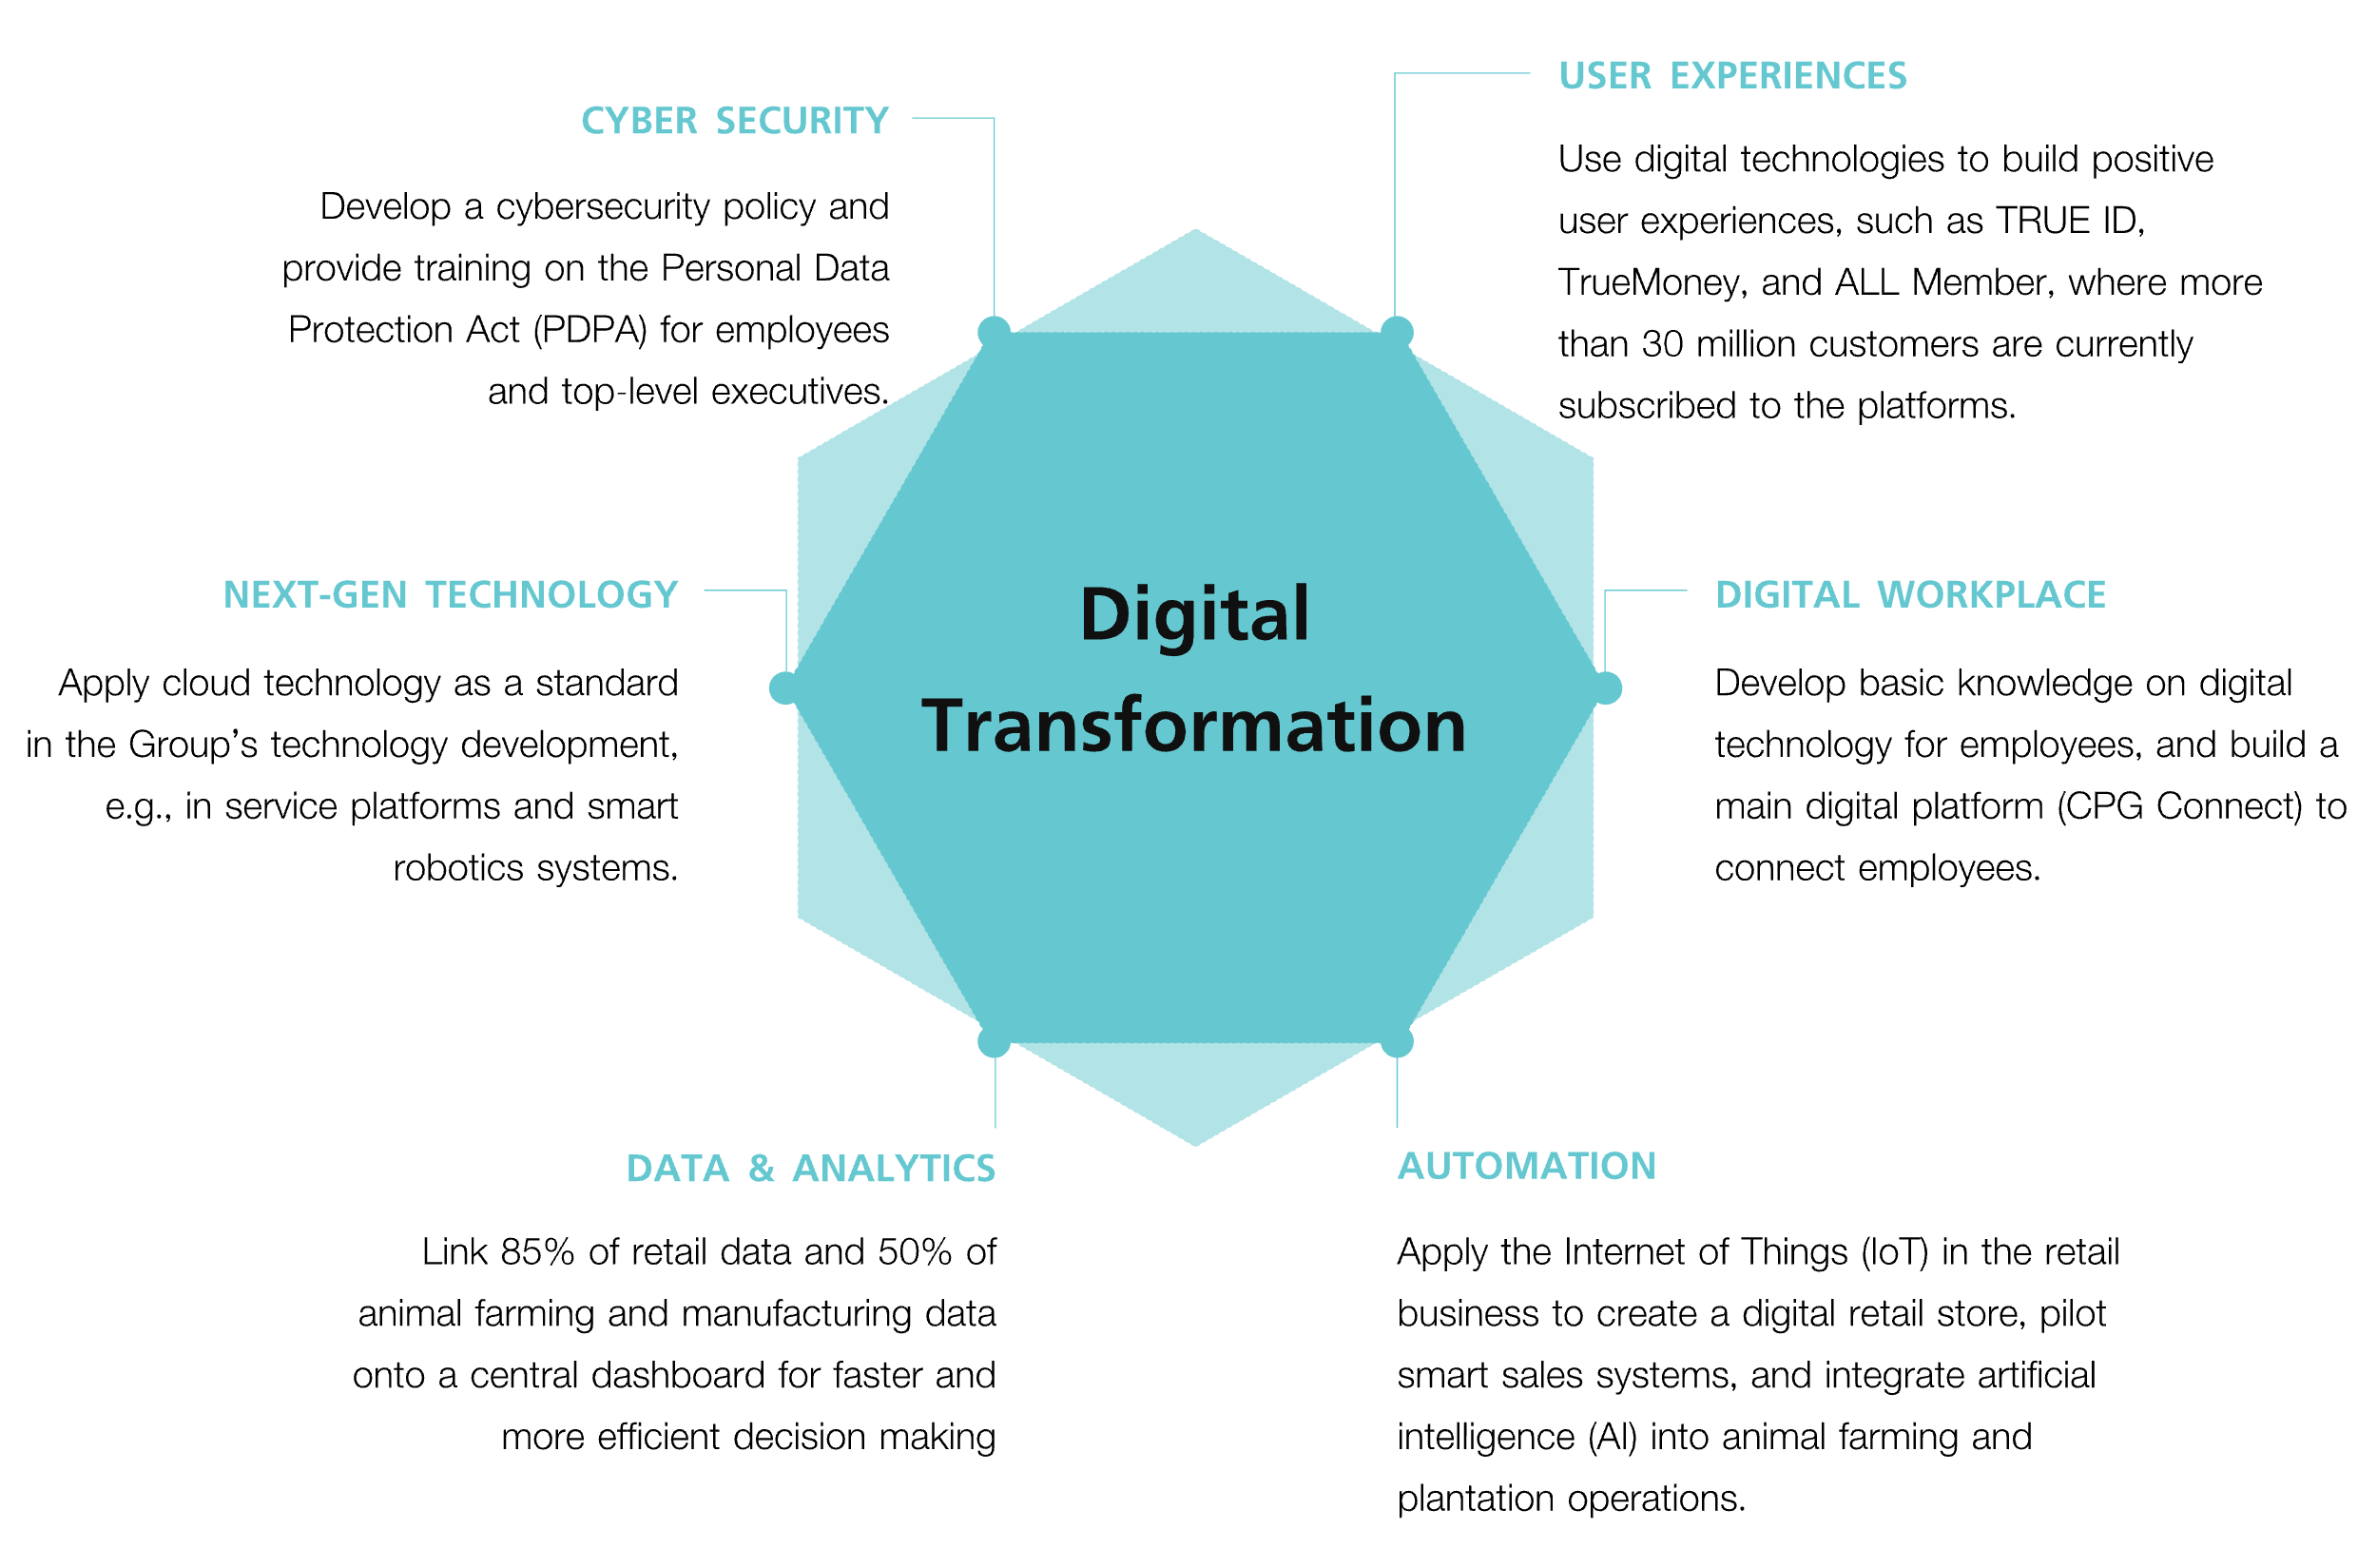

Slide 3
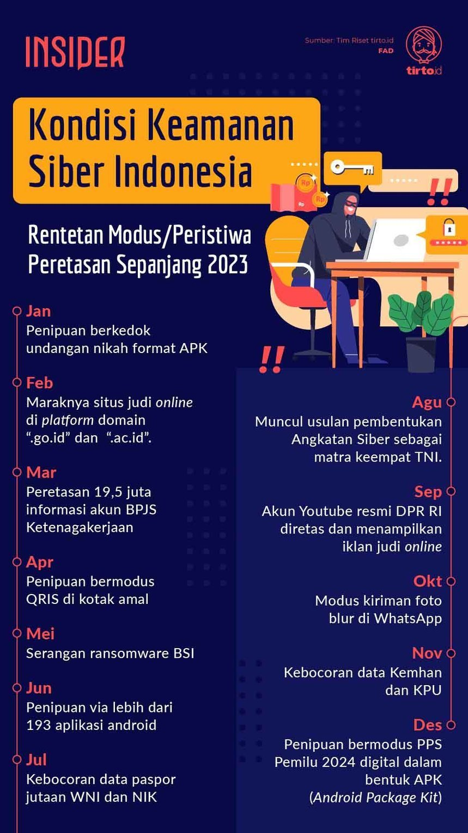
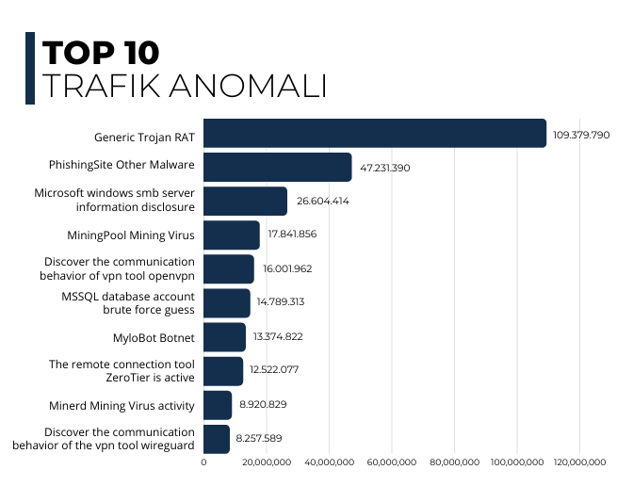
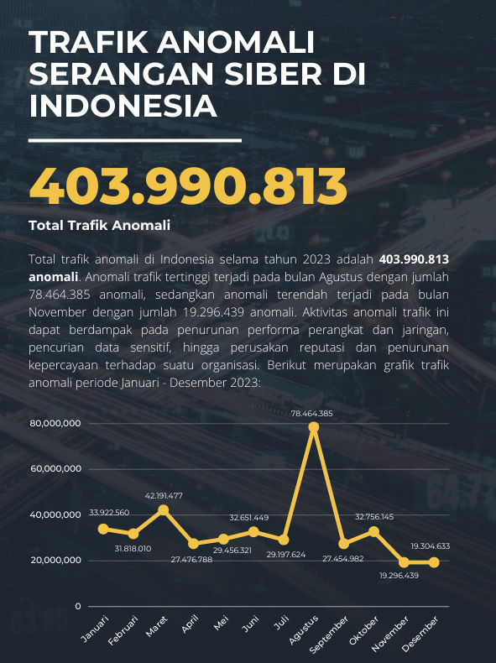
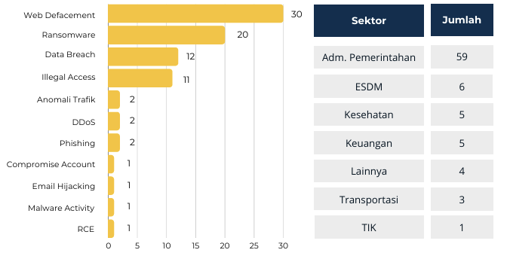
2023
Indonesia Incident Report

Slide 4
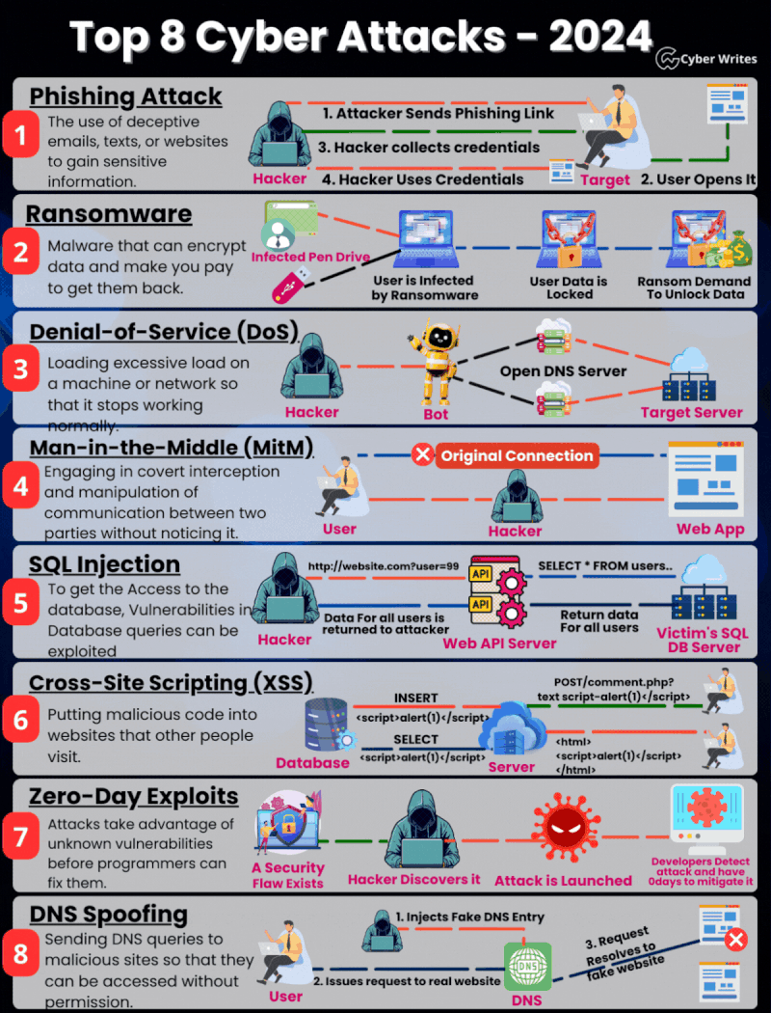
Q1 2024
Global Incident Report
Source: Cyber Writes

Slide 5
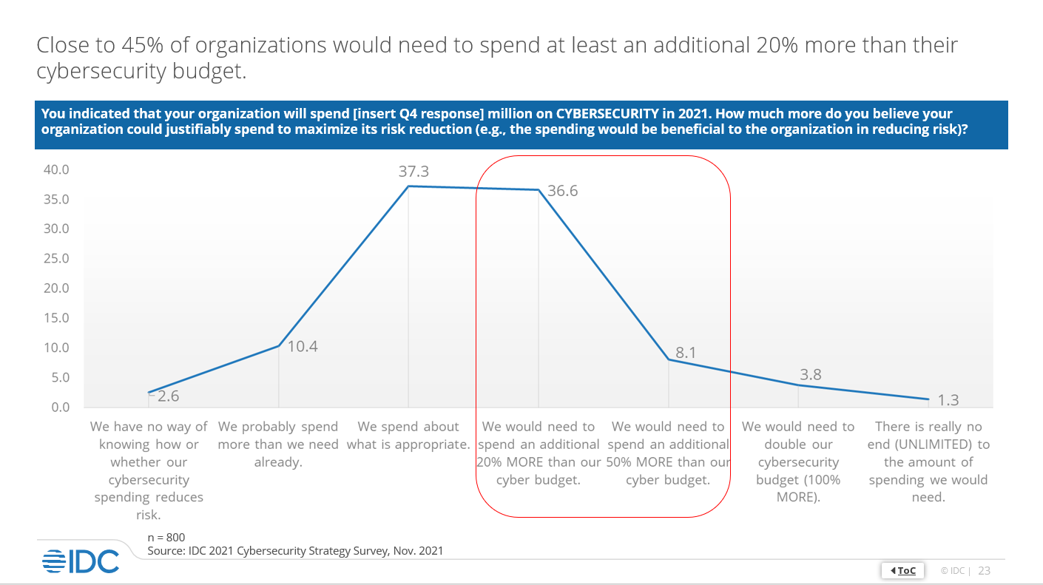
AN INTERCONNECTED WORLD BUT NOT SECURE
Enterprise attack surfaces are expanding. Risks associated with the use of cyber-physical systems and IoT, open-source code, cloud applications, complex digital supply chains, social media and more have brought organizations’ exposed surfaces outside of a set of controllable assets. Organizations must look beyond traditional approaches to security monitoring, detection and response to manage a wider set of security exposures.
(Gartner Identifies Top Security and Risk Management Trends)
Increasing IT security investments
Source: IDC
Source: Gartner

Slide 6
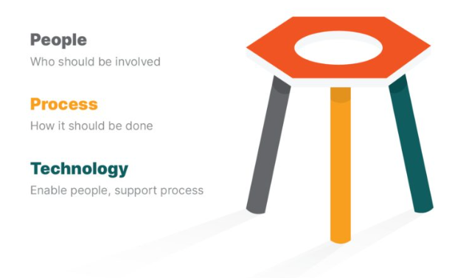
The Challenges that Currently Happening
Challenge:
Do More With Limited Resources
Reduce Complexity
Detect/Respond More Quickly

Slide 7
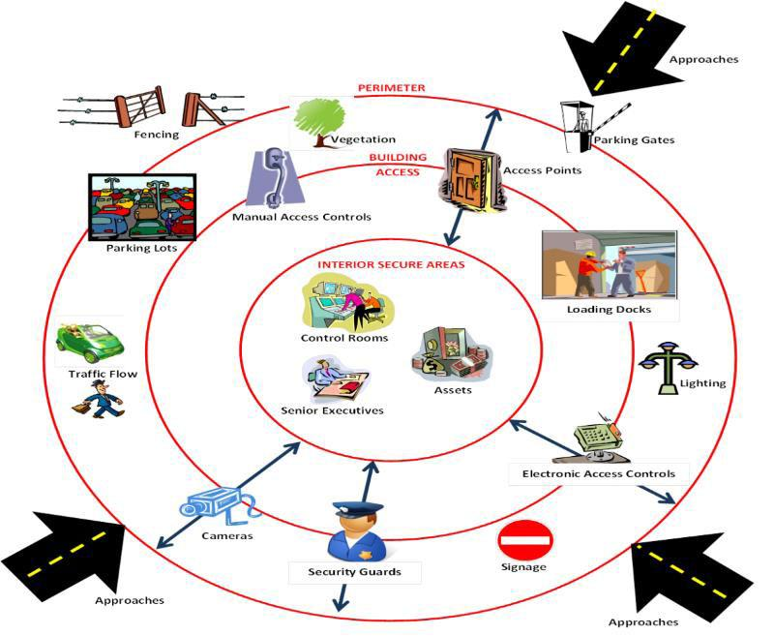
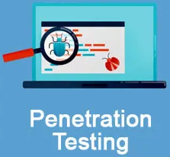
SECURITY PERIMETERS
ANTIDDOS
FIREWALL
WAF
ENDPOINT SECURITY
IPS

Slide 8
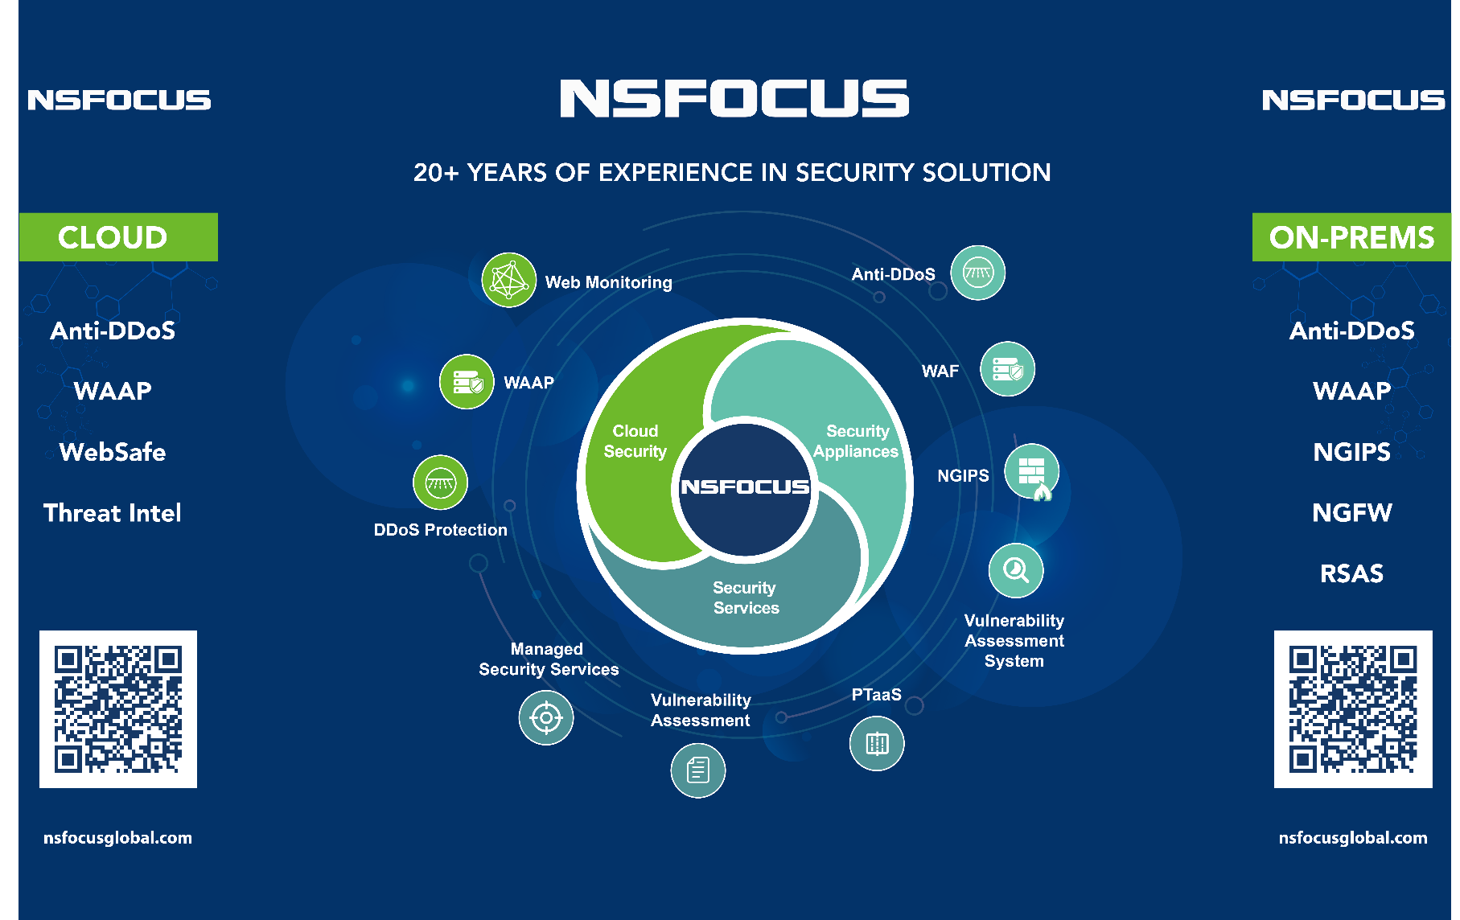
VPT-M
EASM
EASM
Intelligent Operations
Intelligent Security Operations Platform（ISOP) + UTS + MDR
Active Defense Business Operations Platform (ADBOS)
Notes:
Anti-DDoS (ADS Anti-DDoS Protection, NTA Network Traffic Analyzer, FLB, ADSM Anti-DDoS Protection Management, Magic Flow)
WAF (WAF, WAAP)
IPS (NGIPS, TAS)
NGFW
Intrusive Assessment (PTaaS, Red Team, Incident Response, WEBSAFE)
Non-Intrusive Assessment (EASM External Attack Surface Management, WVSS Web Vulnerability Scanning System, RSAS VA, Config Audit, iAST Code Review)
Platform (ISOP Intelligent Security Operation Platform/UTS Unified Threat Sensor+MDR Managed Detection and Response)
Management & Services (ESPC Enterprise Security Planning Customer, ADBOS Active Defense Business Operations System, MSS Manage Security Service, NTI NSFOCUS Threat Intelligence /NTIP NSFOCUS Threat Intelligence Platform)

Slide 9
MORE INFORMATION
Website: www.nsfocusglobal.com
Email: info@nsfocusglobal.com
LinkedIn: https://www.linkedin.com/company/nsfocus/
Facebook: https://www.facebook.com/nsfocus/
Twitter: https://twitter.com/nsfocus_intl

